Slide 1

NAME=SRUSHTI MUDHOLKAR
ROLL NO.=IT-2K19-60
TOPIC=SYSTEM DOCUMENT DESIGN ON CUSTOMER COMPLAINT
MANAGEMENT SYSTEM

Slide 2
SYSTEM DESIGN DESCRIPTION OF CUSTOMER COMPLAINT MANAGEMENT SYSTEM
The purpose of System Design is to create a technical solution that satisfies the functional requirements of the System. A software design document is just a design document to represent a software design i.e to be used for recording design information, addressing various design concerns, and communicating that information to designs stakeholders.

Slide 3
DATABSASE DESIGN
The reason behind database is to handle information as an integrated whole. A database is a collection of irrelated data stored with minimum redundancy to serve many users quickly and efficiently.The main objective is to make information access easy quick and flexible for users.

Slide 4
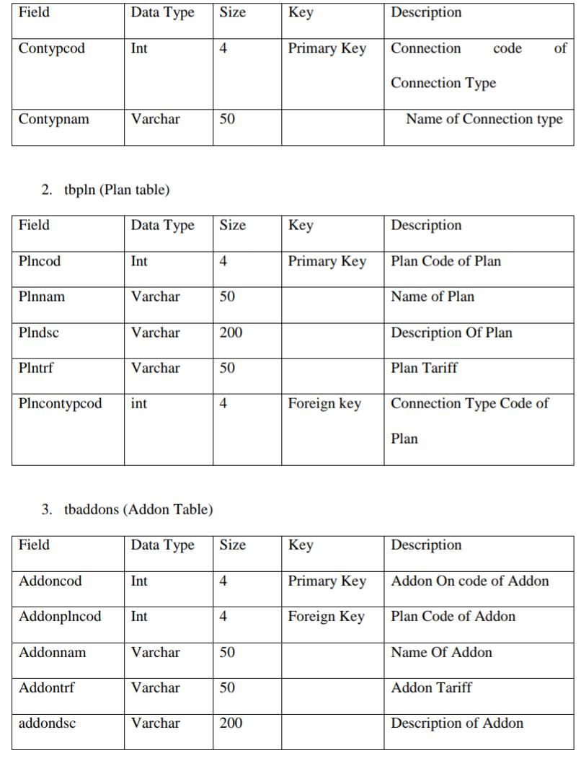
1. Tbcontyp(Connection Table)

Slide 5
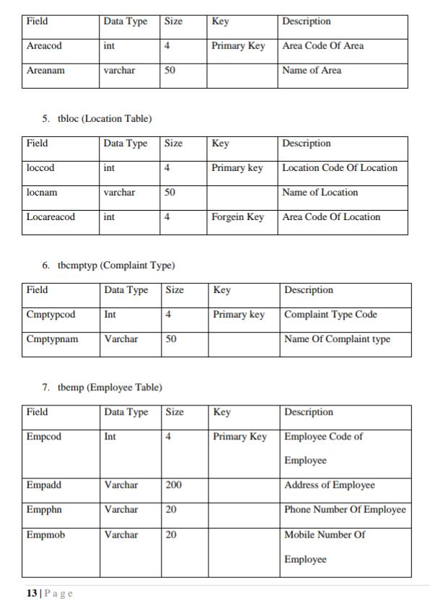
4.tbarea(Area table)

Slide 6
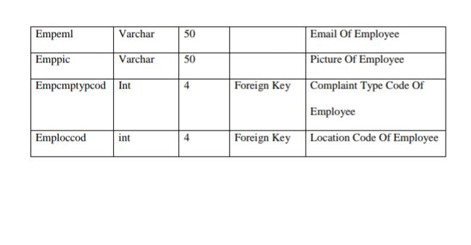

Slide 7
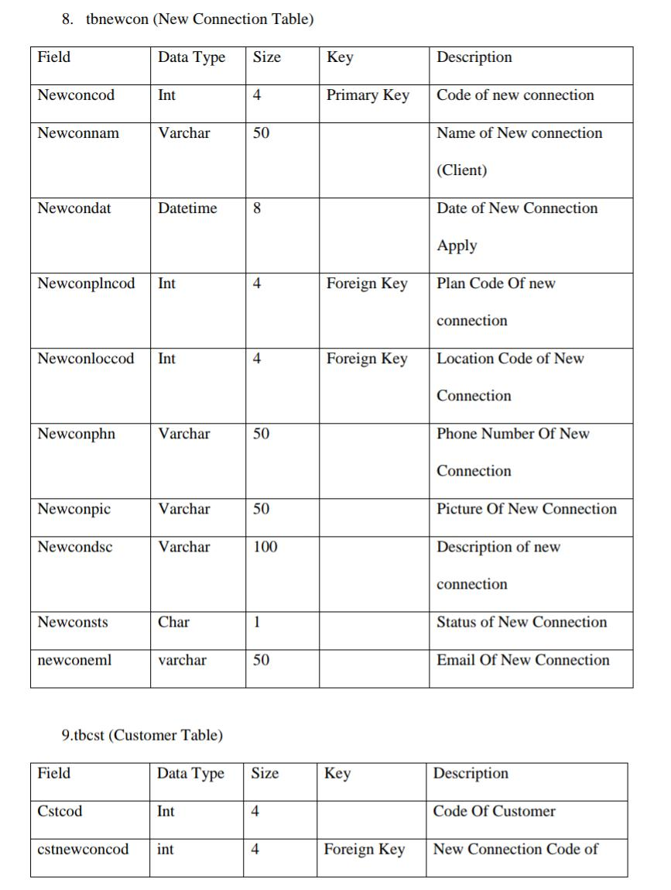

Slide 8
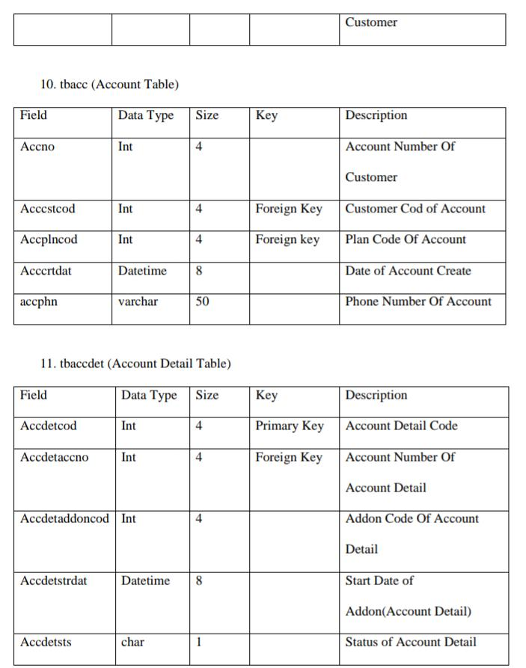

Slide 9
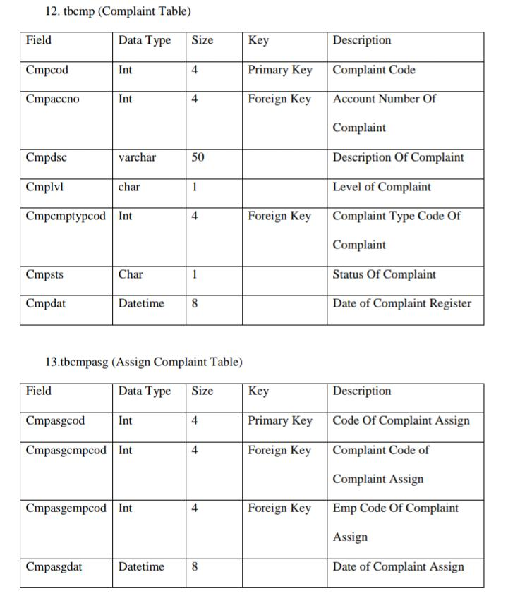

Slide 10
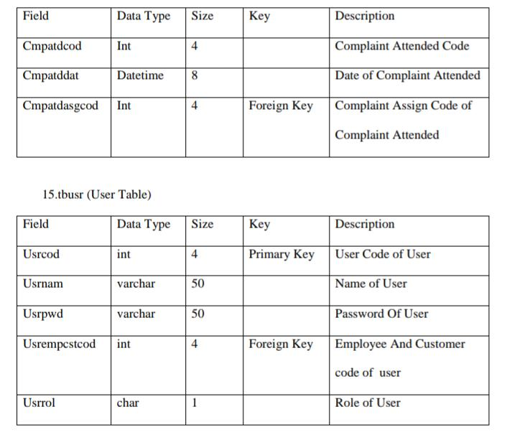
14.tpcmpatd(Complaint Attended)

